Slide 1


Slide 2
Missing Link - Reaching and Linking Men to Health and HIV Services
Helen Ayles
Zambart, Zambia and LSHTM, UK

Slide 3
Men have been the missing link from the HIV agenda in generalized epidemics
Focus on women and girls
Negative or stigmatizing discourse
Criminalization of risk behaviours
  MSM
  Drug use

Slide 4
Why focus on men?
Notes:
In the UNAIDS report it also says that of the 5000 new infections per day 4,500 are in individuals >15 almost 43% are in women ….so 57% are in men……..

Slide 6
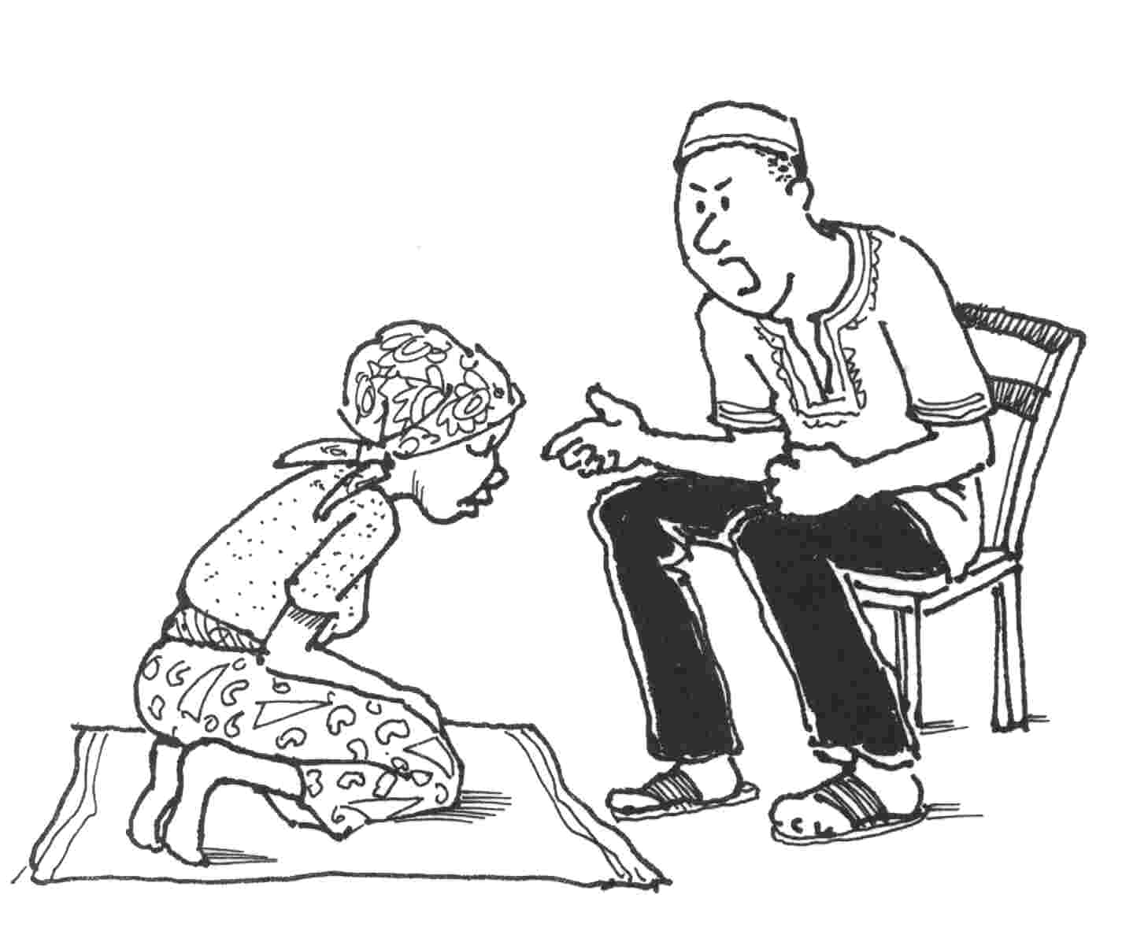
What are the barriers for men?
Men often portrayed negatively in HIV discourse
  Bringing the virus into relationships
  Infecting young women
  Perpetrating GBV
HIV services are less accessible for men
Masculine norms may encourage risk behaviour
  Alcohol use
  Multiple partners
  Gender inequality
Masculine norms may also encourage poor health behaviour
  Alcohol use
  Smoking
  Drug use
  Poor health seeking behaviour
HIV may threaten masculinity “real men don’t get sick”
“Men usually say that HIV testing is for women” DiCarlo et al Culture Health and Sexuality 2014

Slide 7
First find your men….!
Men are NOT
  In your health services
  Often home
Men may be
  At work
  In “male spaces”

Slide 8
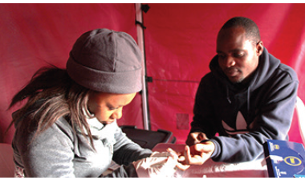
What do we know works?
Mobile testing, campaigns or hubs may be more appealing to men than health services or door-to-door (#THPEC296)
Self-testing may be a good strategy for testing hard to reach groups
Workplace testing may work in some settings

Slide 9
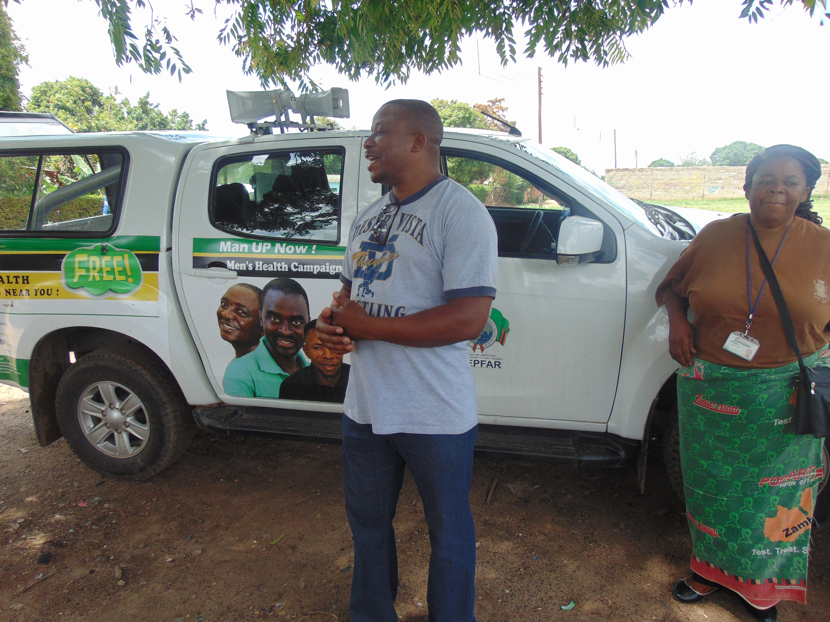
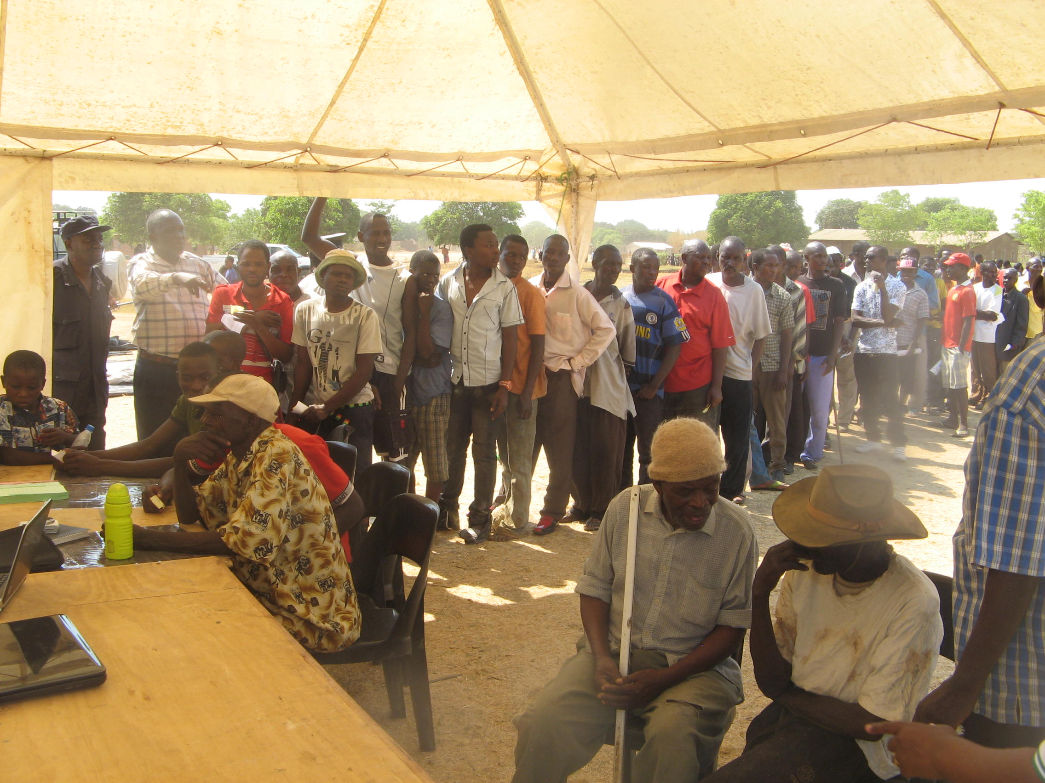
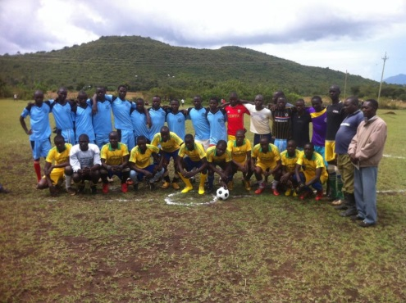
Campaigns and male spaces
Campaigns
  SEARCH multi disease campaigns achieved high uptake of testing and treatment in men
  “Man up!” popular male campaigns
Male Spaces
  VMMC uniquely male preserve
    “Male mentoring camps”
    Sports initiatives
  Male clinics

Slide 10
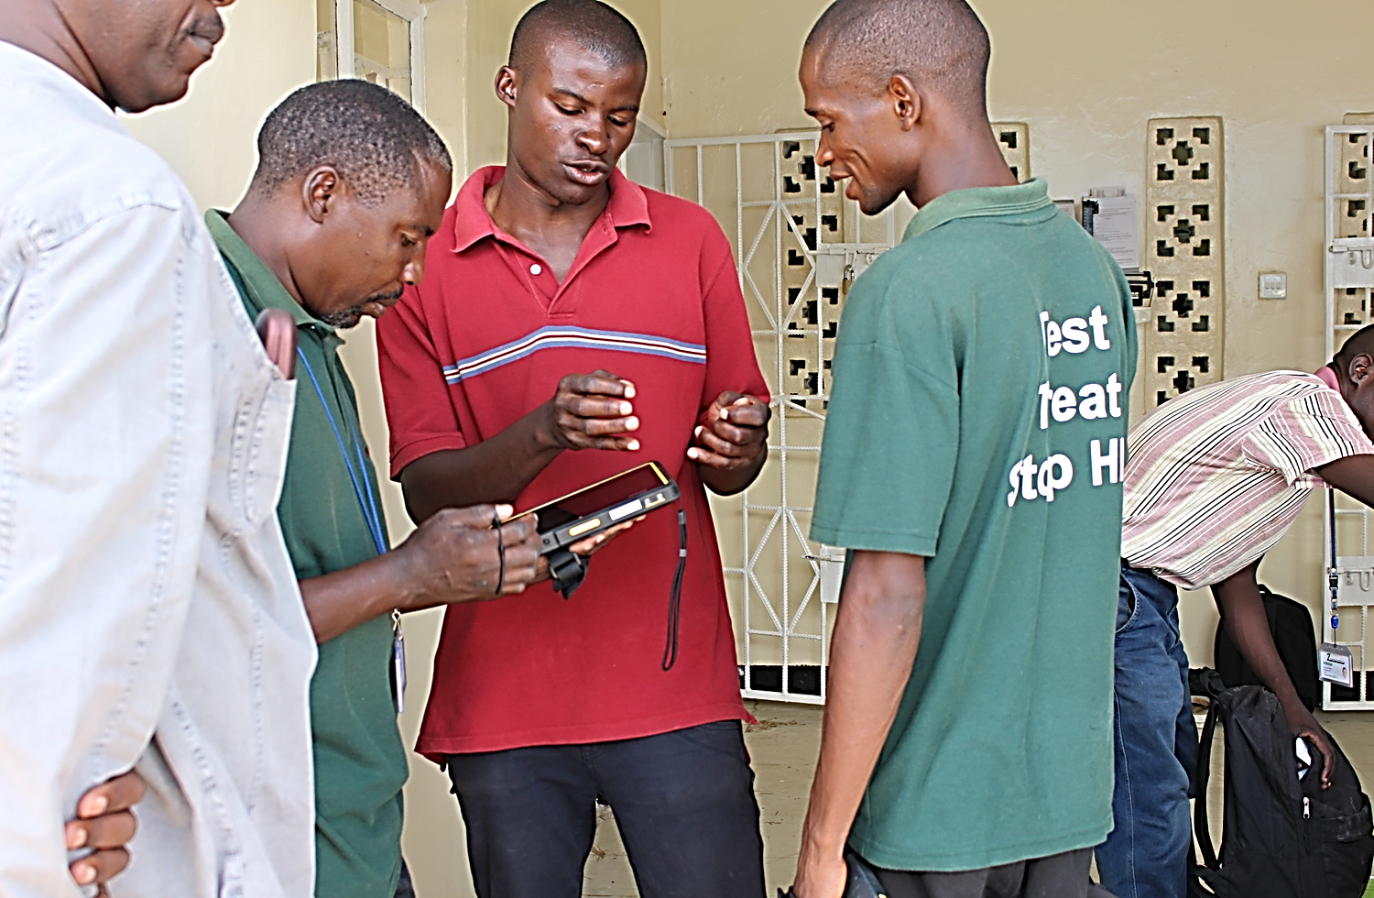
HIV Self-testing
Several studies show self testing reaches men
  In communities
  Via workplace for lorry drivers
  Via secondary distribution from partners
    ANC
    Community (#WEPEC174)

Slide 11
Sessions at this meeting
WEAE01 Reaching men: Yes we can!
TUBS01 Lessons from the UTT Trials
  How did they reach men

Slide 12
Linking men to care
Health facilities are often not male friendly
  Long waiting times
  Interfere with employment opportunities
  May be actively homophobic
Successes
  Male centred facilities
  Longer opening hours
  Appointment systems

Slide 13
…. linkage to care can be as good as for women

Slide 14
But retention and viral suppression may be worse

Slide 15
Worse health outcomes?
Men account for 58% of HIV–related deaths
Co-morbidities may also be higher
  Increased alcohol and drug use
  Increased smoking and cardiovascular risk
  Increased TB

Slide 16
HIV Prevention
VMMC
  Uniquely male space- are we capitalizing on this enough?
  Issues of “manhood” with traditional circumcision and ongoing risks
PrEP
  Mostly being used for MSM in western settings
  How can we expand for other high risk men
Harm reduction strategies
  Hampered by discriminatory legislation

Slide 17
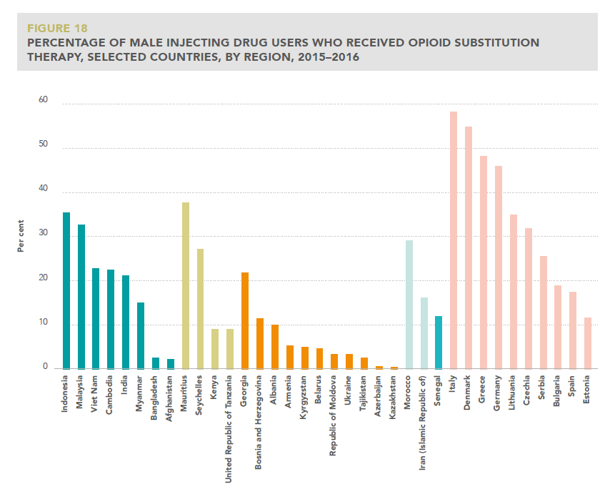

Slide 18
Take home messages?
We have identified this as a problem and now have some strategies to address the problem
More needs to be done especially to reach higher risk men
Challenge is how to ensure equitable access for all
For everyone

